Slide 1
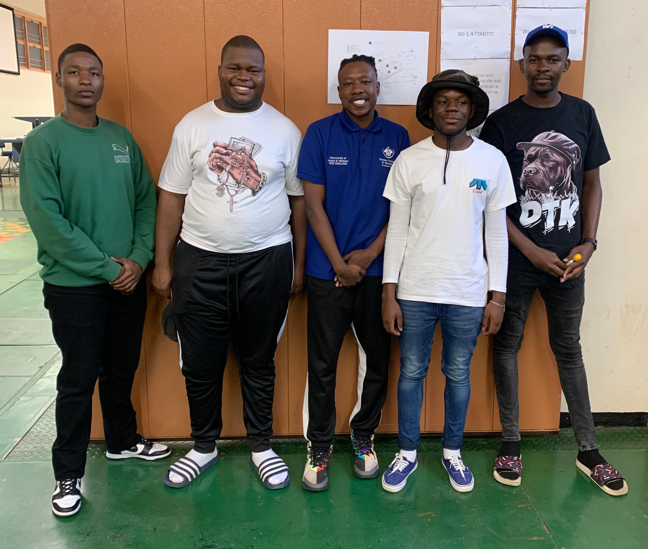
PowerPoint: Smart House Automation System using ESP32 PD1315D
Group Members of Group 4B:
Gafane L.A.
Mokone T.
Baloyi S.T.
Simelane S.
Ganyani M.W.

Slide 2
Table of Contents
Page Numbers | Content
1. | Cover Page
2. | Table of content
3 | Introduction
4. | Components and Distribution Board
5. | Block Diagram
6. | Circuit Diagram
7. | Detailed device wiring overview
8 | Detailed device wiring overview
9. | ESP32 Pin Assignment
10. | Web interface screenshot
11. | Web Interface Code
12. | Device Control Logic
13. | Conclusion

Slide 3
Introduction
This project main aim is to create an affordable and flexible automation system without the need of expensive apps.
- Controlled via a web page hosted on the ESP32 over Wi-Fi.
- User-friendly, low-cost, and scalable smart home solution.
This project involves building a basic smart home system using esp32 microcontroller and Arduino IDE.

Slide 4
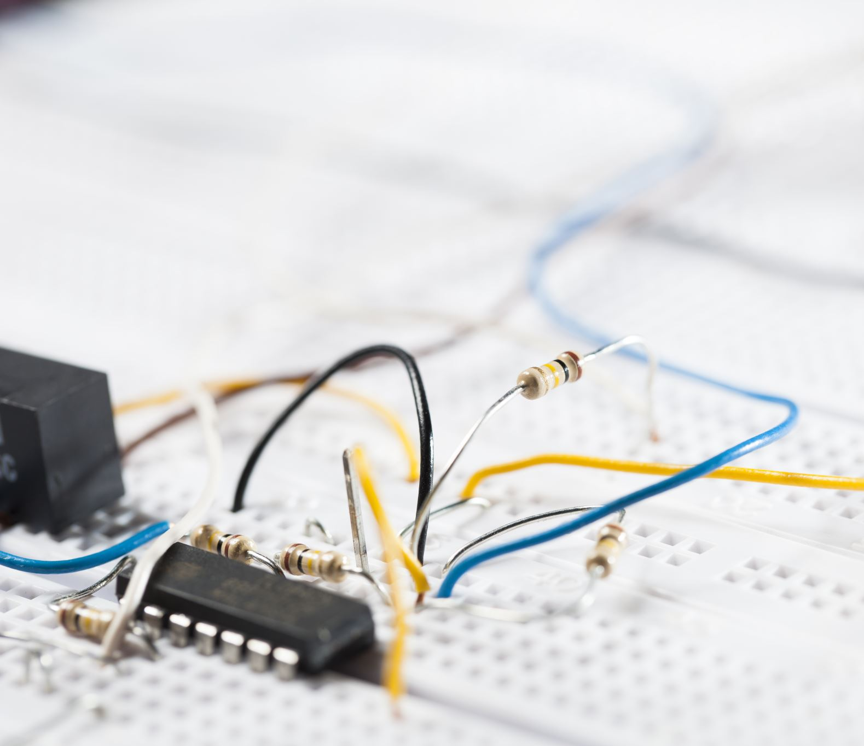
Components and Distribution Board
Components:
- ESP32 Dev Board
- LEDs (x4)
-LEDs(2x to represent the plugs)
- Fan (or DC Motor)
- Sockets (x3)
- 220Ω Resistors
- Breadboard and Jumper Wires
- External Power Source (optional)
USB cable (to upload code to ESP32)
Distribution Board Usage:
- Safely splits AC live and neutral wires.
- Each appliance is isolated and controlled through a relay.
- Ensures safety and scalability for high-voltage devices.

Slide 5
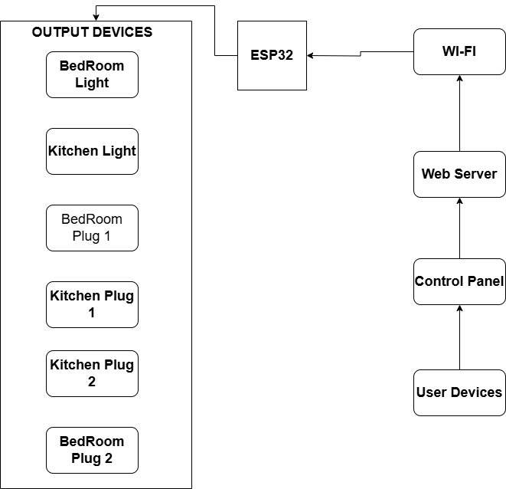
Block Diagram
- Wi-Fi Router ➔ ESP32 (Web Server)
- ESP32 Outputs ➔ Relay Modules
- Relay Modules ➔ Lights, Fan, Sockets

Slide 6
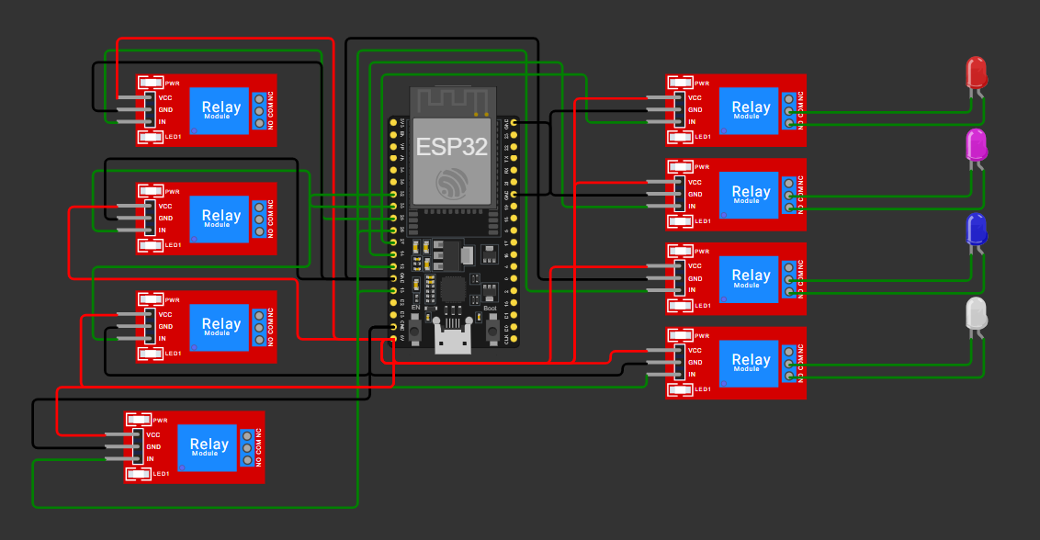
Circuit Diagram
- GPIO Pins:
- Light 1: GPIO 12
- Light 2: GPIO 13
- Light 3: GPIO 14
- Light 4: GPIO 27
- Fan: GPIO 26
- Sockets: GPIO 25, 33, 32
- ESP32 Controls Low Voltage
- Relays Switch High Voltage

Slide 7
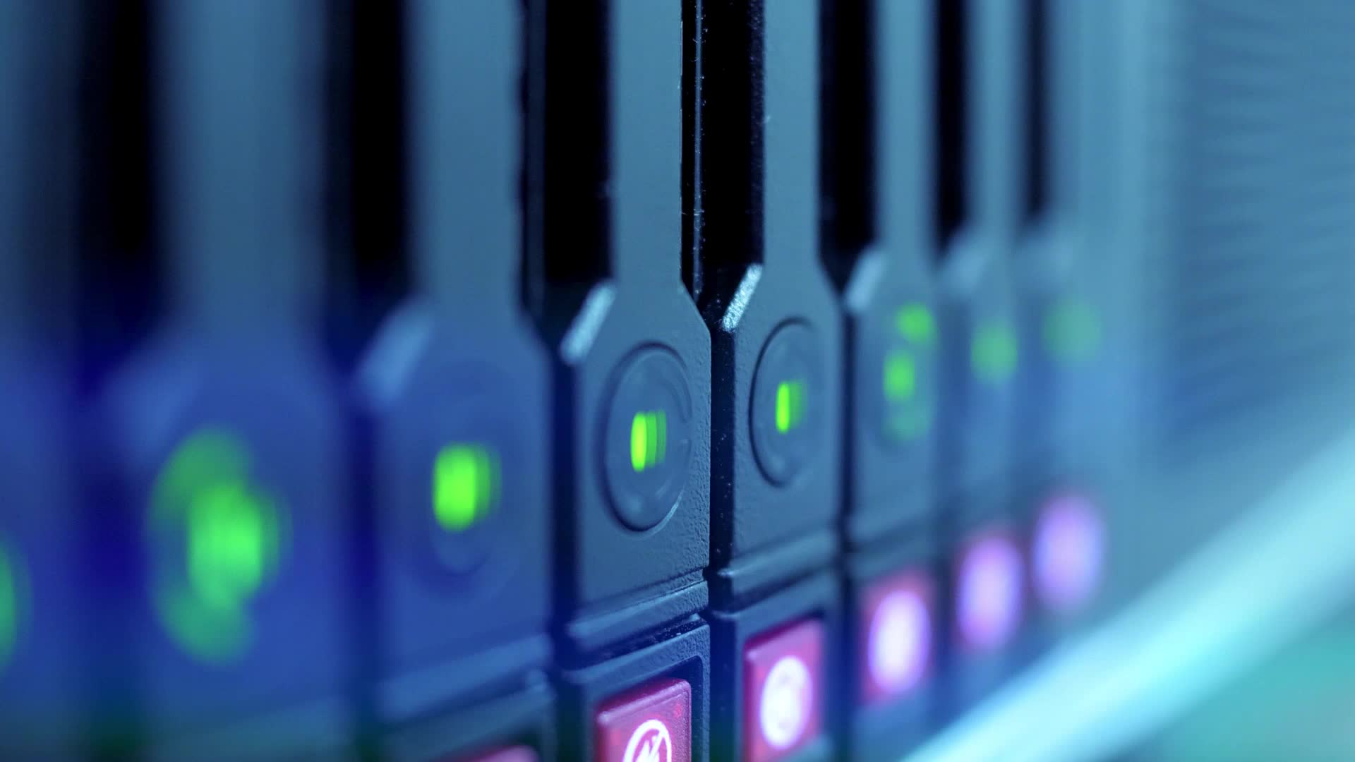
Detailed design
GPIO Control Pins:
Lights Pin:12,13,14,27.
Sockets Pins:25,33,32.
Fan Pin:26.
Microcontroller setup.
ESP 32 DEV module is used.
Configured as wifi web server.
Runs in a simple HTTP server to control lights and plugs
Device control
4 LEDs To simulates lights
2 LEDS To simulated Plugs
Controlled individually through HTTP request from web server

Slide 8
Detailed desigh
Power supply
ESP32 powered with USB cable
LEDs powered from esp32 GPIOs safely using 220 ohm resistors
WIFI configuration
ESP32 connects to home WIFI network
IP address assighned to the router
User accessed ESP32 server through the browser by typing the IP address
Web server Design
Simple web page designed inside the ESP32
HTML links are used for ON/OFF control
Each light sends a specific URL request
Safety
Resistor protects the LEDs from high current

Slide 9
ESP32 Pin Assignment
Pin Assignment:
#define LIGHT1_PIN 12
#define LIGHT2_PIN 13
#define LIGHT3_PIN 14
#define LIGHT4_PIN 27
#define FAN_PIN 26
#define SOCKET1_PIN 25
#define SOCKET2_PIN 33
#define SOCKET3_PIN 32
- Purpose : - Maps physical devices to pin numbers.

Slide 10
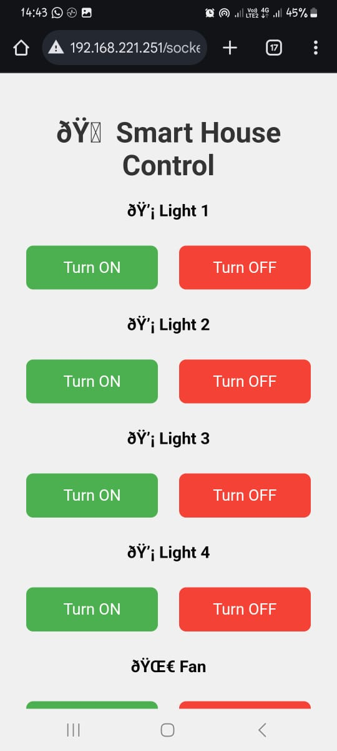
Web interface screenshot

Slide 11
Web Interface Code
void setup()
{
Serial.begin(115200); // Start serial monitor
pinMode(..., OUTPUT); // Set device pins as outputs
WiFi.begin(ssid, password); // Connect to Wi-Fi
server.on("/", handleRoot); // Define homepage route
server.begin(); // Start the web server
}
Purpose : - prepare hardware and WI-FI.
Starts the web Interface for remote control.

Slide 12
Device Control Logic
server.on("/light1/on", []() {
digitalWrite(LIGHT1_PIN, HIGH);
handleRoot();
});
server.on("/light1/off", []() {
digitalWrite(LIGHT1_PIN, LOW);
handleRoot();
});
// Repeated for each device
Purpose: - Allows turning devices on/off remotely.
- each route corresponds to a device action.

Slide 13
Conclusion
The ESP32 Smart Home project was successful. We built a simple and low-cost system that controls 4 lights and 2 plugs through a web browser. The system is fast, easy to use, and does not depend on any external cloud service. Future improvements could include controlling real appliances using relays and adding secure login to the web server.

